Slide 1
Recommender Systems
Collaborative Filtering &
Content-Based Recommending

Slide 2
Recommender Systems
Systems for recommending items (e.g. books, movies, CD’s, web pages, newsgroup messages) to users based on examples of their preferences.
Many websites provide recommendations (e.g. Amazon, NetFlix, Pandora).
Recommenders have been shown to substantially increase sales at on-line stores.
There are two basic approaches to recommending:
  Collaborative Filtering (a.k.a. social filtering)
  Content-based

Slide 3


Book Recommender
Red
Mars
Found
ation
Juras-
sic
Park
User
Profile
Machine
Learning
Lost
World
2001
Neuro-
mancer
2010
Differ-
ence
Engine

Slide 4
Personalization
Recommenders are instances of personalization software.
Personalization concerns adapting to the individual needs, interests, and preferences of each user.
Includes:
  Recommending
  Filtering
  Predicting (e.g. form or calendar appt. completion)
From a business perspective, it is viewed as part of Customer Relationship Management (CRM).

Slide 5
Machine Learning and Personalization
Machine Learning can allow learning a user model or profile of a particular user based on:
  Sample interaction
  Rated examples
This model or profile can then be used to:
  Recommend items
  Filter information
  Predict behavior

Slide 6
Collaborative Filtering
Maintain a database of many users’ ratings of a variety of items.
For a given user, find other similar users whose ratings strongly correlate with the current user.
Recommend items rated highly by these similar users, but not rated by the current user.
Almost all existing commercial recommenders use this approach (e.g. Amazon).

Slide 7

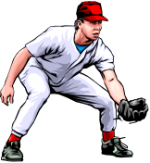

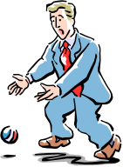

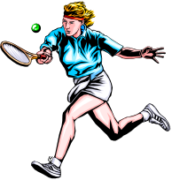

Collaborative Filtering
A 9
B 3
C
: :
Z 5
A
B
C 9
: :
Z 10
A 5
B 3
C
: :
Z 7
A
B
C 8
: :
Z
A 6
B 4
C
: :
Z
A 10
B 4
C 8
. .
Z 1
User
Database
A 9
B 3
C
: :
Z 5
A 10
B 4
C 8
. .
Z 1
Correlation
Match
A 9
B 3
C
. .
Z 5
Extract
Recommendations
Active
User
C

Slide 8
Collaborative Filtering Method
Weight all users with respect to similarity with the active user.
Select a subset of the users (neighbors) to use as predictors.
Normalize ratings and compute a prediction from a weighted combination of the selected neighbors’ ratings.
Present items with highest predicted ratings as recommendations.

Slide 9
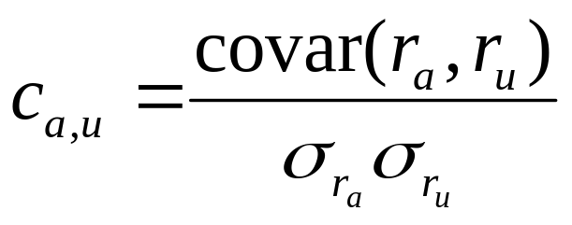
Similarity Weighting
Typically use Pearson correlation coefficient between ratings for active user, a, and another user, u.
r_{a} and r_{u} are the ratings vectors for the m items rated by
both a and u
r_{i,j} is user i’s rating for item j

Slide 10
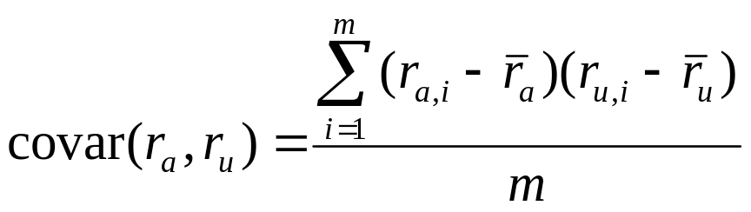
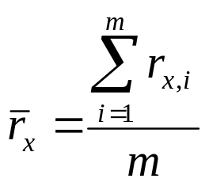
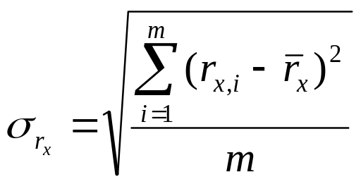
Covariance and Standard Deviation
Covariance:
Standard Deviation:

Slide 11
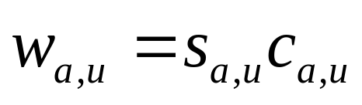
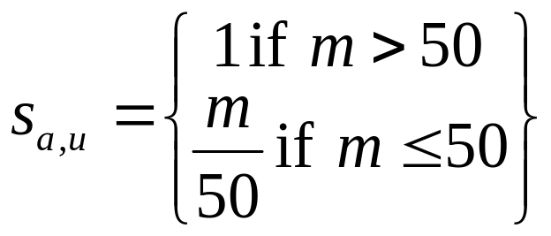
Significance Weighting
Important not to trust correlations based on very few co-rated items.
Include significance weights, s_{a,u}, based on number of co-rated items, m.

Slide 12
Neighbor Selection
For a given active user, a, select correlated users to serve as source of predictions.
Standard approach is to use the most similar n users, u, based on similarity weights, w_{a,u}
Alternate approach is to include all users whose similarity weight is above a given threshold.

Slide 13
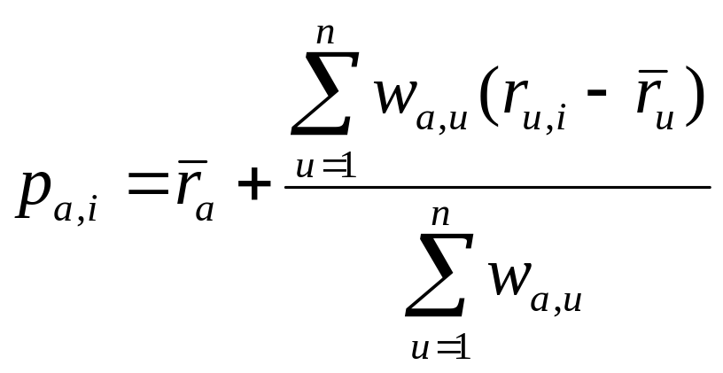
Rating Prediction
Predict a rating, p_{a,i}, for each item i, for active user, a, by using the n selected neighbor users, u ∈ {1,2,…n}.
To account for users different ratings levels, base predictions on differences from a user’s average rating.
Weight users’ ratings contribution by their similarity to the active user.

Slide 14
Problems with Collaborative Filtering
Cold Start: There needs to be enough other users already in the system to find a match.
Sparsity: If there are many items to be recommended, even if there are many users, the user/ratings matrix is sparse, and it is hard to find users that have rated the same items.
First Rater: Cannot recommend an item that has not been previously rated.
  New items
  Esoteric items
Popularity Bias: Cannot recommend items to someone with unique tastes.
  Tends to recommend popular items.

Slide 15
Content-Based Recommending
Recommendations are based on information on the content of items rather than on other users’ opinions.
Uses a machine learning algorithm to induce a profile of the users preferences from examples based on a featural description of content.
Some previous applications:
  Newsweeder (Lang, 1995)
  Syskill and Webert (Pazzani et al., 1996)

Slide 16
Advantages of Content-Based Approach
No need for data on other users.
  No cold-start or sparsity problems.
Able to recommend to users with unique tastes.
Able to recommend new and unpopular items
  No first-rater problem.
Can provide explanations of recommended items by listing content-features that caused an item to be recommended.

Slide 17
Disadvantages of Content-Based Method
Requires content that can be encoded as meaningful features.
Users’ tastes must be represented as a learnable function of these content features.
Unable to exploit quality judgments of other users.
  Unless these are somehow included in the content features.

Slide 18
LIBRA
Learning Intelligent Book Recommending Agent
Content-based recommender for books using information about titles extracted from Amazon.
Uses information extraction from the web to organize text into fields:
  Author
  Title
  Editorial Reviews
  Customer Comments
  Subject terms
  Related authors
  Related titles

Slide 19
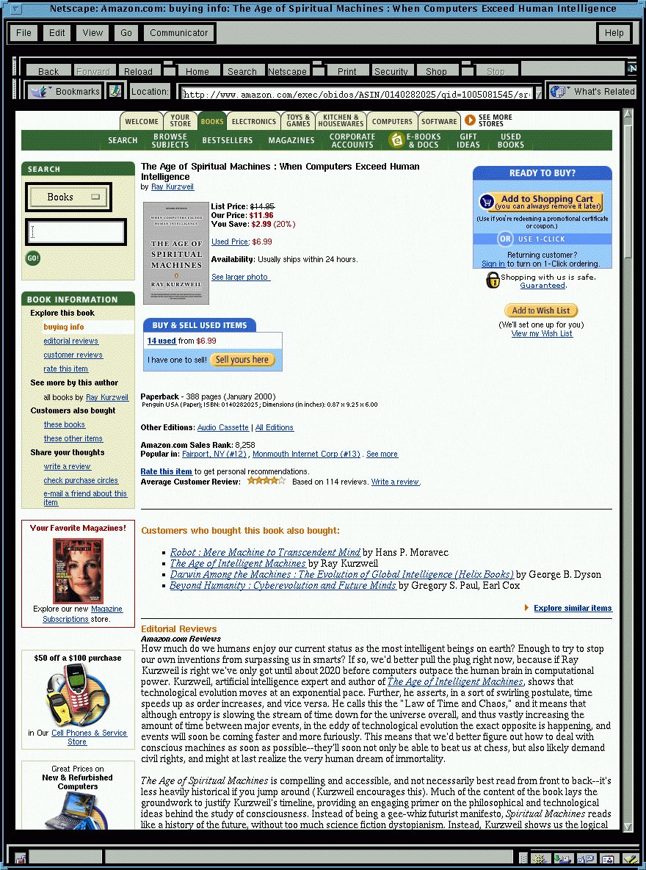

LIBRA System
Amazon Pages
LIBRA Database
Information
Extraction
Rated
Examples
Machine Learning
Learner
Recommendations
1.~~~~~~
2.~~~~~~~
3.~~~~~
:
:
:
User Profile
Predictor

Slide 20
Sample Amazon Page
Age of Spiritual Machines

Slide 21
Sample Extracted Information
Title: <The Age of Spiritual Machines: When Computers Exceed Human Intelligence>
Author: <Ray Kurzweil>
Price: <11.96>
Publication Date: <January 2000>
ISBN: <0140282025>
Related Titles: <Title: <Robot: Mere Machine or Transcendent Mind>
Author: <Hans Moravec> >
…
Reviews: <Author: <Amazon.com Reviews> Text: <How much do we humans…> >
…
Comments: <Stars: <4> Author: <Stephen A. Haines> Text:<Kurzweil has …> >
…
Related Authors: <Hans P. Moravec> <K. Eric Drexler>…
Subjects: <Science/Mathematics> <Computers> <Artificial Intelligence> …

Slide 22
Libra Content Information
Libra uses this extracted information to form “bags of words” for the following slots:
  Author
  Title
  Description (reviews and comments)
  Subjects
  Related Titles
  Related Authors

Slide 23
Libra Overview
User rates selected titles on a 1 to 10 scale.
Libra uses a naïve Bayesian text-categorization algorithm to learn a profile from these rated examples.
  Rating 6–10: Positive
  Rating 1–5: Negative
The learned profile is used to rank all other books as recommendations based on the computed posterior probability that they are positive.
User can also provide explicit positive/negative keywords, which are used as priors to bias the role of these features in categorization.

Slide 24
Bayesian Categorization in LIBRA
Model is generalized to generate a vector of bags of words (one bag for each slot).
  Instances of the same word in different slots are treated as separate features:
    “Chrichton” in author vs. “Chrichton” in description
Training examples are treated as weighted positive or negative examples when estimating conditional probability parameters:
  An example with rating 1 ≤ r ≤ 10 is given:
  positive probability: (r – 1)/9
  negative probability: (10 – r)/9

Slide 25
Implementation
Stopwords removed from all bags.
A book’s title and author are added to its own related title and related author slots.
All probabilities are smoothed using Laplace estimation to account for small sample size.
Lisp implementation is quite efficient:
  Training: 20 exs in 0.4 secs, 840 exs in 11.5 secs
  Test: 200 books per second

Slide 26
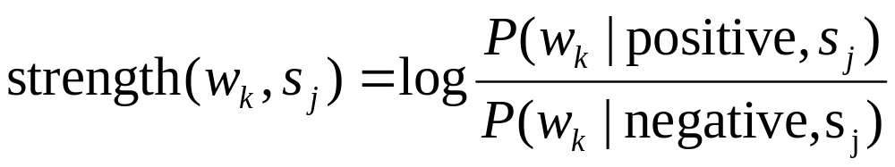
Explanations of Profiles and Recommendations
Feature strength of word w_{k} appearing in a slot s_{j} :

Slide 27
Libra Demo
http://www.cs.utexas.edu/users/libra

Slide 28
Experimental Data
Amazon searches were used to find books in various genres.
Titles that have at least one review or comment were kept.
Data sets:
  Literature fiction: 3,061 titles
  Mystery: 7,285 titles
  Science: 3,813 titles
  Science Fiction: 3.813 titles

Slide 29
Rated Data
4 users rated random examples within a genre by reviewing the Amazon pages about the title:
  LIT1 936 titles
  LIT2 935 titles
  MYST 500 titles
  SCI 500 titles
  SF 500 titles

Slide 30
Experimental Method
10-fold cross-validation to generate learning curves.
Measured several metrics on independent test data:
  Precision at top 3: % of the top 3 that are positive
  Rating of top 3: Average rating assigned to top 3
  Rank Correlation: Spearman’s, r_{s}, between system’s and user’s complete rankings.
Test ablation of related author and related title slots (LIBRA-NR).
  Test influence of information generated by Amazon’s collaborative approach.

Slide 31
Experimental Result Summary
Precision at top 3 is fairly consistently in the 90’s% after only 20 examples.
Rating of top 3 is fairly consistently above 8 after only 20 examples.
All results are always significantly better than random chance after only 5 examples.
Rank correlation is generally above 0.3 (moderate) after only 10 examples.
Rank correlation is generally above 0.6 (high) after 40 examples.

Slide 32
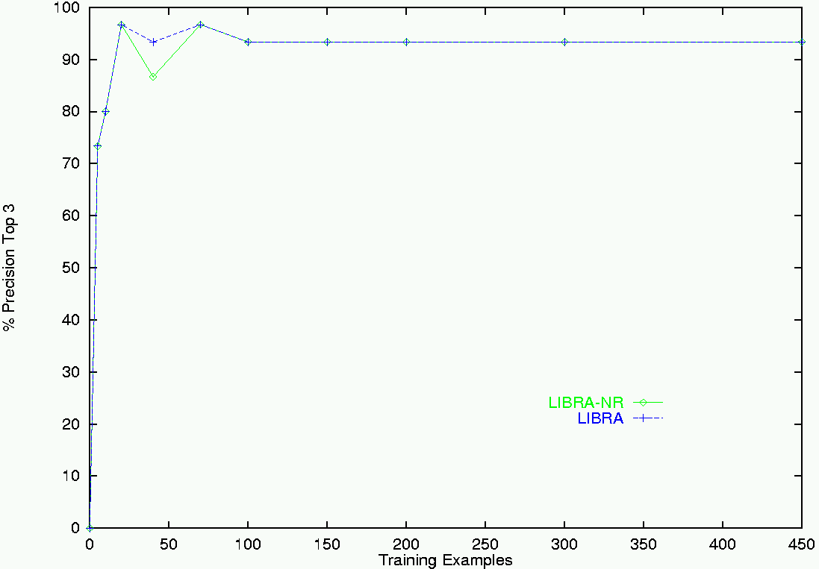
Precision at Top 3 for Science

Slide 33
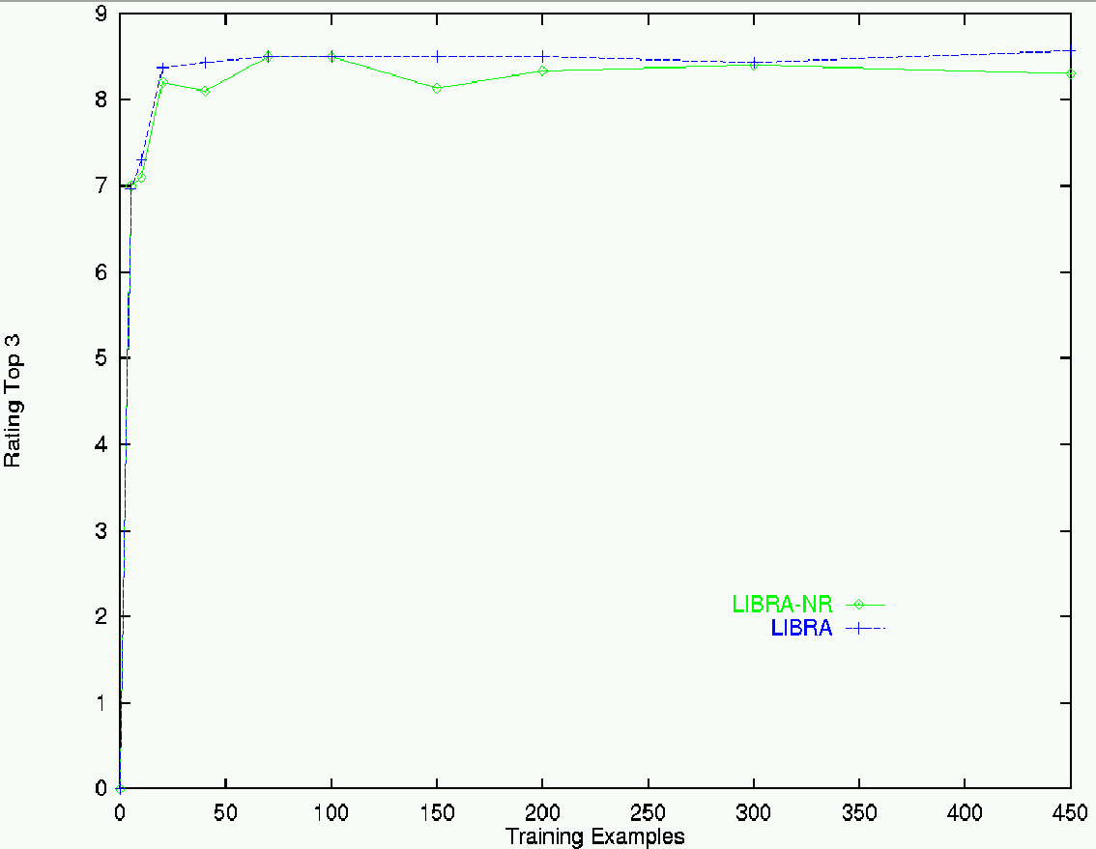
Rating of Top 3 for Science

Slide 34
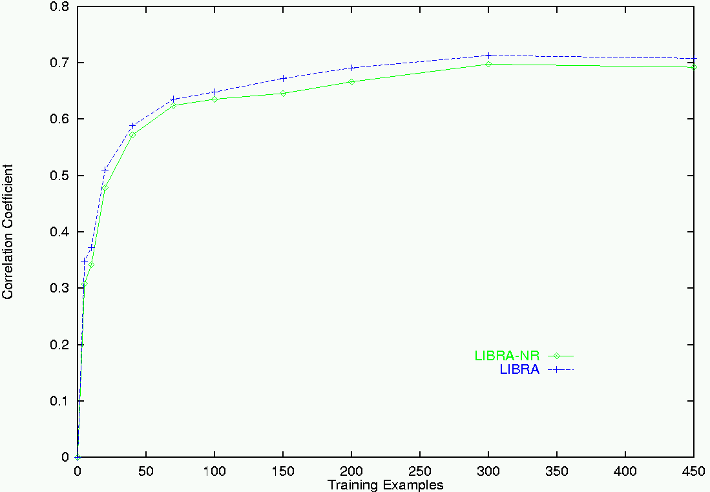
Rank Correlation for Science

Slide 35
User Studies
Subjects asked to use Libra and get recommendations.
Encouraged several rounds of feedback.
Rated all books in final list of recommendations.
Selected two books for purchase.
Returned reviews after reading selections.
Completed questionnaire about the system.

Slide 36
Combining Content and Collaboration
Content-based and collaborative methods have complementary strengths and weaknesses.
Combine methods to obtain the best of both.
Various hybrid approaches:
  Apply both methods and combine recommendations.
  Use collaborative data as content.
  Use content-based predictor as another collaborator.
  Use content-based predictor to complete collaborative data.

Slide 37
Movie Domain
EachMovie Dataset [Compaq Research Labs]
  Contains user ratings for movies on a 0–5 scale.
  72,916 users (avg. 39 ratings each).
  1,628 movies.
  Sparse user-ratings matrix – (2.6% full).
Crawled Internet Movie Database (IMDb)
  Extracted content for titles in EachMovie.
Basic movie information:
  Title, Director, Cast, Genre, etc.
Popular opinions:
  User comments, Newspaper and Newsgroup reviews, etc.

Slide 38
Content-Boosted Collaborative Filtering
EachMovie
Web Crawler
IMDb
Movie
Content
Database
User Ratings
Matrix (Sparse)
Full User
Ratings Matrix
Content-based
Predictor
Active
User Ratings
Collaborative
Filtering
Recommendations

Slide 39
Content-Boosted CF - I
User-ratings Vector
Training Examples
Content-Based
Predictor
Pseudo User-ratings Vector
User-rated Items
Unrated Items
Items with Predicted Ratings

Slide 40
Content-Boosted CF - II
User Ratings
Matrix
Pseudo User
Ratings Matrix
Content-Based
Predictor
Compute pseudo user ratings matrix
  Full matrix – approximates actual full user ratings matrix
Perform CF
  Using Pearson corr. between pseudo user-rating vectors

Slide 41
Experimental Method
Used subset of EachMovie (7,893 users; 299,997 ratings)
Test set: 10% of the users selected at random.
  Test users that rated at least 40 movies.
  Train on the remainder sets.
Hold-out set: 25% items for each test user.
  Predict rating of each item in the hold-out set.
Compared CBCF to other prediction approaches:
  Pure CF
  Pure Content-based
  Naïve hybrid (averages CF and content-based predictions)

Slide 42
Metrics
Mean Absolute Error (MAE)
  Compares numerical predictions with user ratings
ROC sensitivity [Herlocker 99]
  How well predictions help users select high-quality items
  Ratings ≥ 4 considered “good”; < 4 considered “bad”
Paired t-test for statistical significance

Slide 43
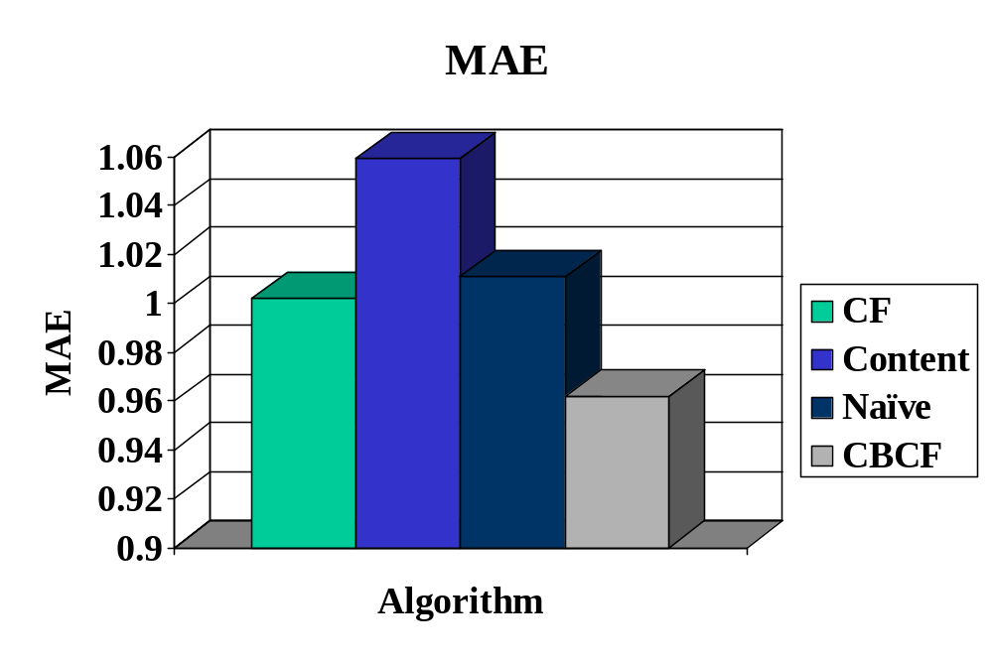
Results - I
CBCF is significantly better (4% over CF) at (p < 0.001)

Slide 44
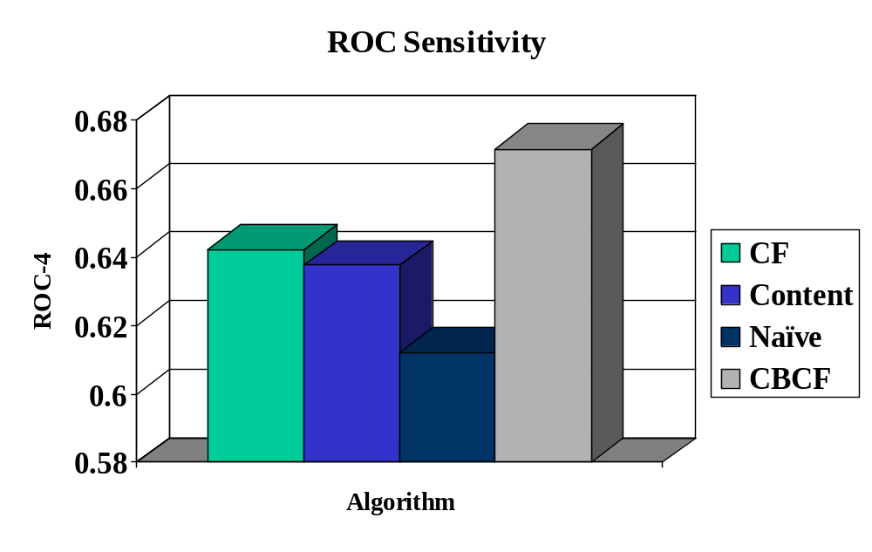
Results - II
CBCF outperforms rest (5% improvement over CF)

Slide 45
Active Learning
(Sample Section, Learning with Queries)
Used to reduce the number of training examples required.
System requests ratings for specific items from which it would learn the most.
Several existing methods:
  Uncertainty sampling
  Committee-based sampling

Slide 46
Semi-Supervised Learning
(Weakly Supervised, Bootstrapping)
Use wealth of unlabeled examples to aid learning from a small amount of labeled data.
Several recent methods developed:
  Semi-supervised EM (Expectation Maximization)
  Co-training
  Transductive SVM’s

Slide 47
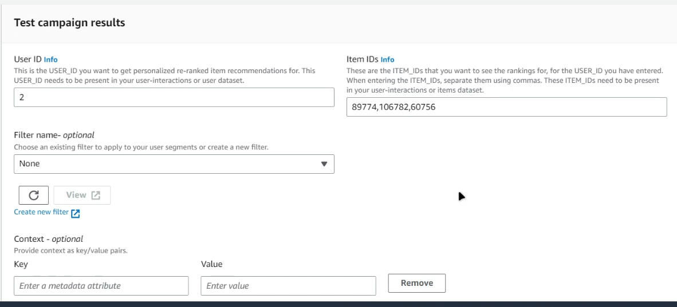
Screenshot of Implementation of AWS Recommendation System(Example:1)

Slide 48
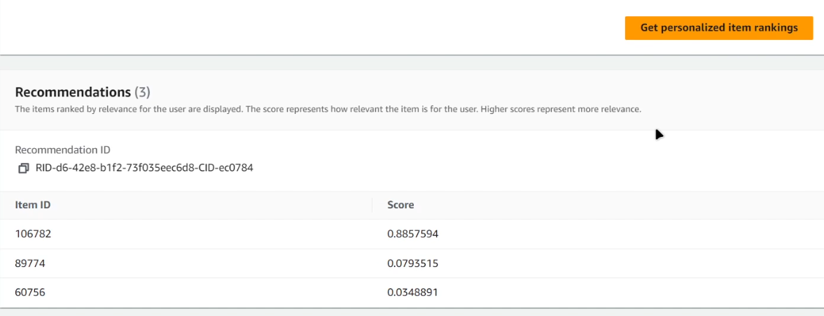
Results(Example:1)

Slide 49
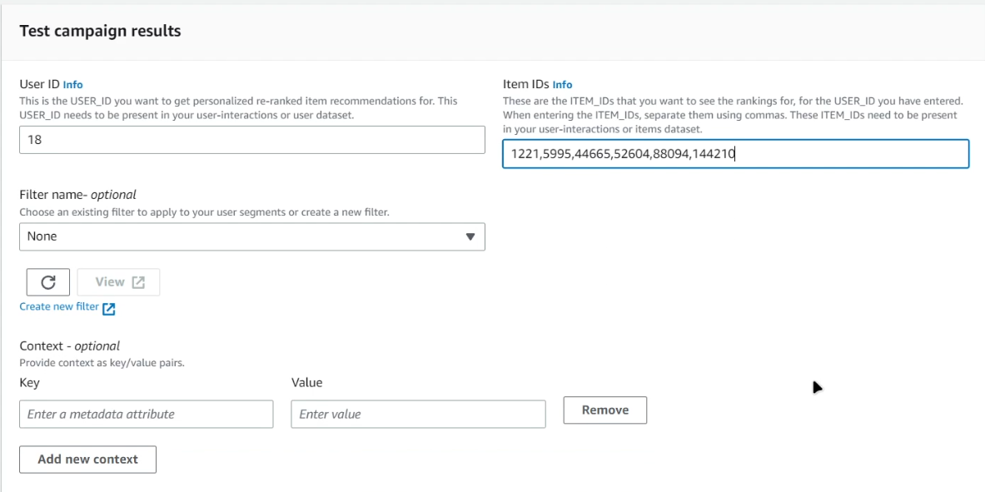
Example:2

Slide 50
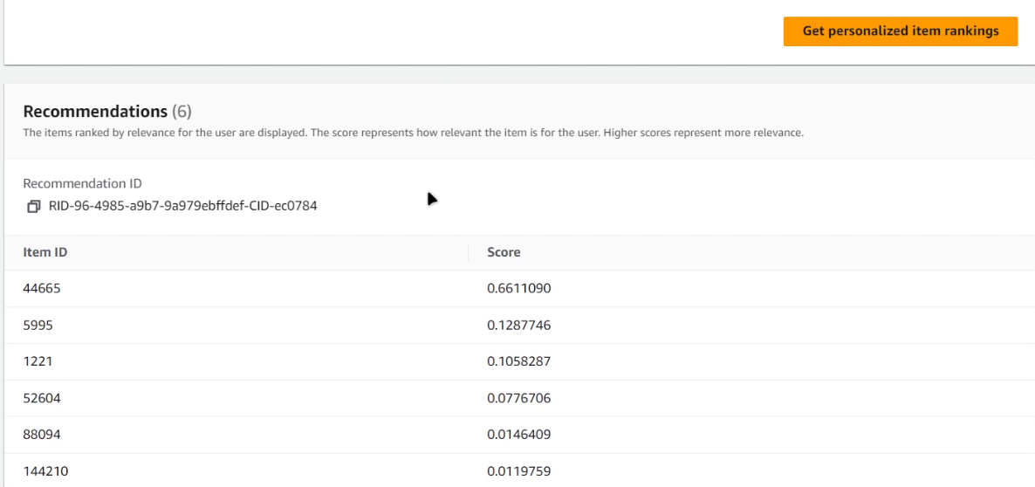
Results(Example:2)

Slide 51
Conclusions
Recommending and personalization are important approaches to combating information over-load.
Machine Learning is an important part of systems for these tasks.
Collaborative filtering has problems.
Content-based methods address these problems (but have problems of their own).
Integrating both is best.

